Slide 1

Newham Child Neglect Tool Kit
Natalie Newton –NSCP Service Manager
Elena Nicolaou – LBN CYPS Workforce Development Lead
9th June 2026

Slide 2
Welcome and Purpose
Introduce the Newham Neglect Toolkit and its three practice tools:
Child Neglect Checklist
Child Neglect Screening Tool
Child Neglect Identification Tool (Assessment)
Strengthen a shared multi-agency understanding of neglect and its impact on children, young people and families in Newham
This tool provides the opportunity to work collaboratively to bring together shared information, that may be held in single agencies. This is linked to Working Together 2026 and the forthcoming Social Care Reforms (Multi-agency Child Protection Teams, Family Help teams with Targeted Help and Social Workers together).
Promote consistent, confident and reflective practice across the partnership
Child neglect is the most common form of child maltreatment in England and features in over 50% of safeguarding reviews. It is often under-recognised, inconsistently defined, and responded to too late, despite its long-term impact on children’s health, development, safety, and wellbeing.

Slide 3
What will you take away
Support practitioners to identify neglect earlier and respond effectively through child-centred, strengths-based and trauma-informed practice
Reinforce the importance of working with families, not to families, in line with Children’s Social Care reforms and Family Shared Decision Making principles
Promote approaches that build on family strengths, wider networks and community support to help safely keep families together wherever possible
Highlight the importance of professional curiosity, lived experience and understanding contextual factors including poverty, adversity and inequality
Share learning from implementation in Waltham Forest and opportunities for cross-borough collaboration and shared learning
Introduce ongoing support, feedback and learning opportunities to help embed the toolkit across services and partnership practice

Slide 4
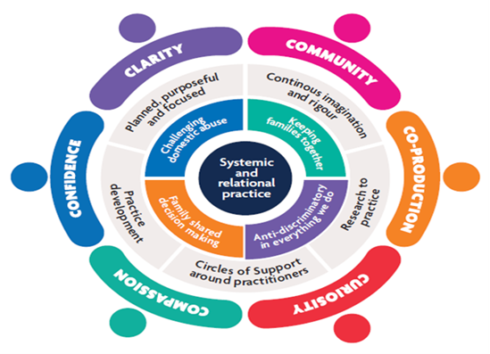
Align neglect practice with Newham’s practice model, including:
Circles of Support (the 6 C’s)
Relationship-based practice
Anti-discriminatory and anti-oppressive practice as the “golden thread” throughout our work with children and families

Slide 5
Reflections from senior leaders and partners on the importance of recognising and responding to neglect and supporting consistent practice across agencies
Tim Desai – MET Police
Noshin Mohammed- LBN PSW
Pauline Grant – LBN 0-19 Health Service
Sophie Groenvynck – LBN Education

Slide 6




Children Health
0-19 Service
The importance of Health role in identifying Neglect

Slide 7
Health’s role in identifying neglect through the HCP
The Healthy Child Programme 2026 is England’s public health framework for ages 0–19.
Through health visiting and school nursing, the HCP
-combines universal and targeted support to prevent escalating issues,
-champions early intervention
-contributes to the identification of neglect, abuse or unmet health needs.
All health professionals are required to make every contact count:
-embed safeguarding practice within every contact with children and families
-respond appropriately to emerging concerns
-ensure timely intervention to prevent escalation and protect children’s wellbeing

Slide 8
Neglect indicators- (HCP 0-19 Contacts)
Age group | Indicator | 0-19 contacts
Infant & Early years 0-5 (Health visiting) | Home environment (clutter, damp, safety hazards, etc) Inconsistent feeding, hygiene concerns, unsafe sleep environments Poor weight gain, growth concerns, developmental delay Limited parent-infant interaction/attachment concerns | Antenatal visit, New birth visit, 6-8 weeks, follow up home visits 12-16 week, clinics, developmental review checks
Pre-school and school age (Universal/targeted reviews) | Frequent missed appointments / poor engagement with services Delays in speech, language and social development Inadequate clothing, poor hygiene, untreated health conditions Concerns raised by early years settings or schools | A&E notifications (health records) 9-12 months developmental review 2-2.5 years dev review Clinics/groups Information sharing
School Age and Adolescence (5-19) | Persistent absence or poor school engagement Emotional wellbeing concerns (withdrawal, low self-esteem, behaviour changes) Risk-taking behaviours (substance use, exploitation risk, lack of supervision) Unmet health needs (e.g. chronic conditions not managed, missed immunisations) | -Information sharing (school health referral) -School drop in clinics -National Child Measurement Programme -Vision and hearing screening -Individual health care planning -Parent drop-in sessions
Cross-cutting indicators (all ages) | Repeated A&E attendances / patterns of injury or illness Parental factors: mental health, substance misuse, domestic abuse Housing instability, overcrowding, poverty-related stressors Lack of follow-through on advice, support or referrals | -A&E notifications (health records) -Health records -Disclosures -Health needs assessments -Home visits/clinic attendances
Notes:
Regular, scheduled contact → early pattern recognition
Home‑based reviews → direct observation of caregiving environment
Universal reach → no family is missed
Targeted & specialist levels → escalation when concerns arise
Integrated working → information sharing across agencies
Responding to Suspected Neglect within HCP
Use local safeguarding tools, thresholds and referral pathways.
Document concerns clearly and share appropriately.
Offer targeted support (e.g., parenting programmes, frequent visits).
Engage in multi‑agency meetings and early help assessments.
Continue monitoring through HCP reviews.

Slide 9
Neglect indicators-Traffic Light approach
Early Help (Emerging Concerns) Low level or single indicators | Targeted Support (Escalating concerns) Multiple/persistent indicators | Safeguarding (Significant harm/Risk of harm) Serious/cumulative neglect
Occasional missed appointment or late engagement Mild home environment concerns (clutter) Early signs of developmental delay or parenting inconsistency Basic care needs mostly met but with some gaps Family experiencing financial or housing pressures | Repeated missed appointments Ongoing concerns on hygiene, nutrition, supervision Developmental delay/unmet health needs Home environment impacting safety (damp, overcrowding, hazard) Parental factors (mental health, substance misuse, DV) | Child’s basic needs consistently unmet Unsafe home conditions posing immediate risk Non-engagement wit services despite concerns Significant impact on health, growth or development Evidence of chronic neglect or compounding risk factors
Action: Advice and signpost for early help Monitor through HCP contacts | Action: Initiate early help/multi agency support Use neglect tool to assess cumulative risk Safeguarding supervision | Action: Immediate safeguarding referral (MASH) Follow escalation pathways Share information and seek supervision
Notes:
Physical
Poor growth, faltering weight, untreated medical issues, missed health appointments
Emotional
Withdrawn behaviour, lack of attachment, inconsistent caregiving
Environmental
Unsafe or unhygienic home conditions
Developmental
Delayed milestones, poor school attendance
Parental factors
Mental health issues, substance misuse, domestic abuse (These align with what HCP reviews are designed to detect.)

Slide 10
Anti-poverty & Anti-Discriminatory practice
Recognising the link between poverty and neglect
Poverty increases risk factors (e.g. housing instability, food insecurity, parental stress)
Poverty is not neglect-requires professional curiosity
Avoiding bias and discriminatory practice
Risk of over identifying neglect in marginalised communities
Risk of under-identifying in more ‘hidden’ or less visible families
Practice must be fair, consistent and evidence-informed
HCP focus on Inequalities and Proportionate Universalism
Targeted support for families with greatest needs
Equity-driven approach to reduce health and safeguarding inequalities
Strengths-based and culturally competent practice
Addressing wider determinants alongside safeguarding
Professional curiosity and reflective practice
Notes:
Understand family context, culture and lived experience
Work in partnership with families, not just assessment of risk
Link families into support: housing, benefits, early help, community resources
Neglect often improves when underlying socio-economic issues are addressed
Challenge assumptions and unconscious bias
Use supervision and safeguarding frameworks to ensure balanced decision-making

Slide 11

Key
Takeaways
Healthy Child Programme Importance
  The Healthy Child Programme is a vital tool for safeguarding children's health and wellbeing in early stages.
Early Identification and Intervention
  The neglect tool will support Health professionals play a crucial role in identifying neglect early and intervening effectively to protect children.
Collaboration and Professional Curiosity
  Maintaining professional curiosity and collaborating with others enhances safeguarding outcomes for vulnerable children.
Information Sharing
  Sharing concerns of neglect with children social care, contributing to multiagency assessments and decision making is important
Shared Responsibility
  Safeguarding is everyone’s business, therefore, all professionals have a responsibility to identifying signs of neglect to ensure timely intervention.
Notes:
The key takeaways from this presentation are that the Healthy Child Programme is a vital safeguarding tool, neglect is often cumulative and easily missed, and health professionals play a crucial role in early identification and intervention. Every contact counts, patterns matter, and the child’s lived experience must remain central to practice. By maintaining professional curiosity, using structured HCP contacts effectively, and working collaboratively, health professionals can make a significant difference in safeguarding vulnerable children.

Slide 12

SUMMARY
The Healthy Child Programme 2026 provides a structured, evidence‑based framework that enables early identification of neglect.
Health Visitors/School Nurses must use every contact as an opportunity to assess safety, wellbeing, and family context.
Mandated reviews, proportionate universalism, and multi‑agency collaboration make neglect detection a core function of public health nursing.
Notes:
Effective safeguarding depends on strong multi-agency working. The Healthy Child Programme operates within a wider system that includes social care, education, and voluntary services. This slide highlights the importance of information sharing, collaboration, and shared responsibility. Working together ensures a more comprehensive understanding of the child’s circumstances and reduces the risk of concerns being overlooked.

Slide 13
Introducing the Newham Child Neglect Toolkit
Child Neglect Checklist
This checklist aims to help with identifying child neglect and is for professionals who go into people’s homes and might see things that others wouldn’t see.
You can use this checklist to record anything that you’ve seen, heard or smelled in a home where there are children, and something hasn’t felt quite right.

Slide 15
Child Neglect Screening Tool
This multi-agency child neglect screening tool is designed to help you consider whether a child (0-18) is subject to neglect and what needs to happen next.
It can help to provide a plan of support or get another agency involved. Remember child neglect that is not responded to, just gets worse.
Change is unlikely without intervention. Early action really does help. You can include all children in this one tool.

Slide 16
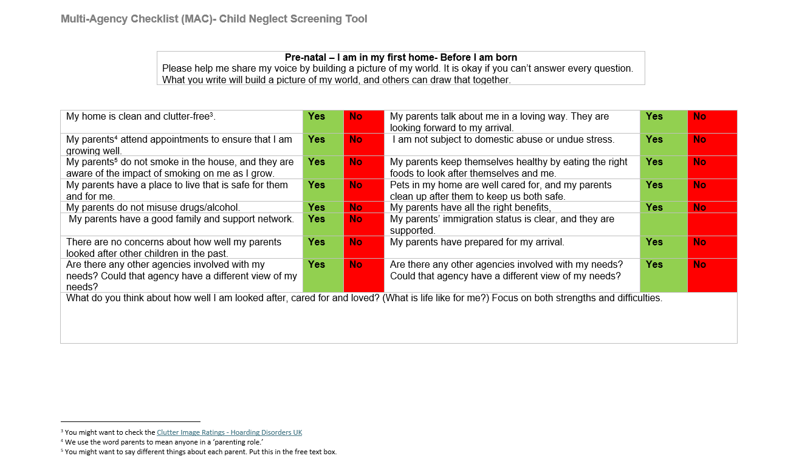
Notes:
If there are any red answers (indicating a concern), consider how you or your service can help the parents/carers meet this need. You should also consider whether a referral or signposting to another service, including children's centres, early help, or children's social care, would be helpful. In deciding what next steps should be, you might want to use the Newham Child Neglect Toolkit, which will provide a more detailed review of the child(ren)'s circumstances.
It is expected that this will be completed by one practitioner, drawing on the knowledge held by other agencies and the family itself. If information about some sections is not available to the practitioner completing them, it is worth asking other agencies or simply stating that the information is not known.
The level of detail provided in the text boxes under each section is down to the professional judgement of each practitioner completing it. It will be essential to ensure that the child's lived experience is clear. Proactively seek and record the child’s lived experience through regular, direct engagement and observation. Prioritise home visits that include seeing the child in their home environment and speaking to them alone, challenging yourself about times when it is not appropriate to involve the child.
This is an opportunity to include parents from the start, and reasons for not doing so should be recorded. Differences of opinion by parents/family should also be apparent. This should be a parent-and-partnership model, with a “Think Family” focus.
This screening tool is intended to support the development of single agency support plans, mobilization of support from others, supporting an early help response and making a referral to children’s social care, alongside other assessment processes.

Slide 17
Child Neglect Identification Tool (assessment)
The identification tool is designed for all practitioners (in any role) who have concerns that a child's developmental needs are not being met bet by their parents (pre-birth to 18).
This tool is broken down into categories:
1. Physical care
2. Children’s health and disabilities
3. Safety and supervision
4. Love and care
5. Stimulation and education
There is an analysis and plan section at the end of the document. You can complete one per child or you may complete for several children in the same family.

Slide 18
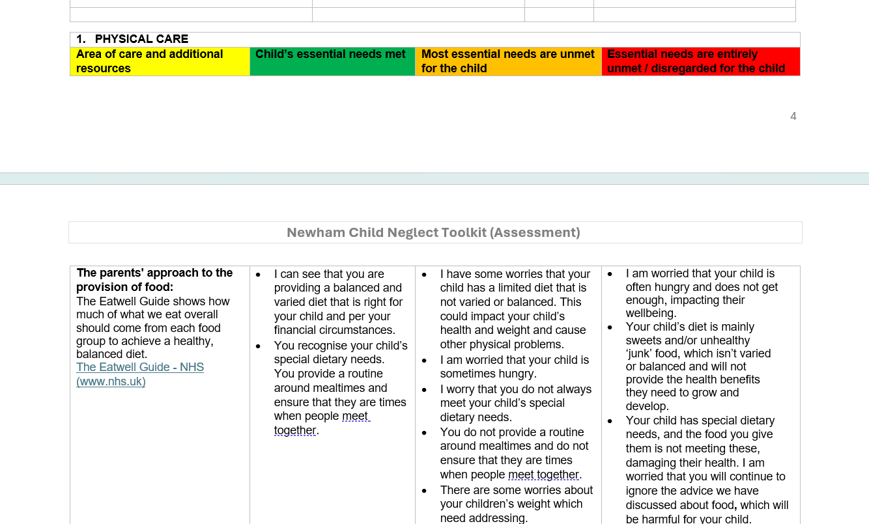

Slide 19
Embedding the Toolkit Across the Partnership
Support available for teams and practitioners
Invitations to service meetings, forums and partnership networks
Forthcoming listening/Q&A events
Wednesday 16th July 10:00am – 11:00am
Wednesday 17 September 10:00am – 11:00am
Neglect ambassadors – please get in touch with Natalie and Elena if support is needed
Natalie.Newton@newham.gov.uk and Elena.Nicolaou@newham.gov.uk

Slide 20
Questions and Closing Remarks
Thank you for your time.

